Slide 1


CC Procurement Approval Rules Setup
Adhish Gosavi

Slide 2
1. Requisition
  A purchase requisition typically contains the description and quantity of the goods or services to be purchased, a required delivery date, account number and the amount of money that the purchasing department is authorized to spend for the goods or services.

Slide 3
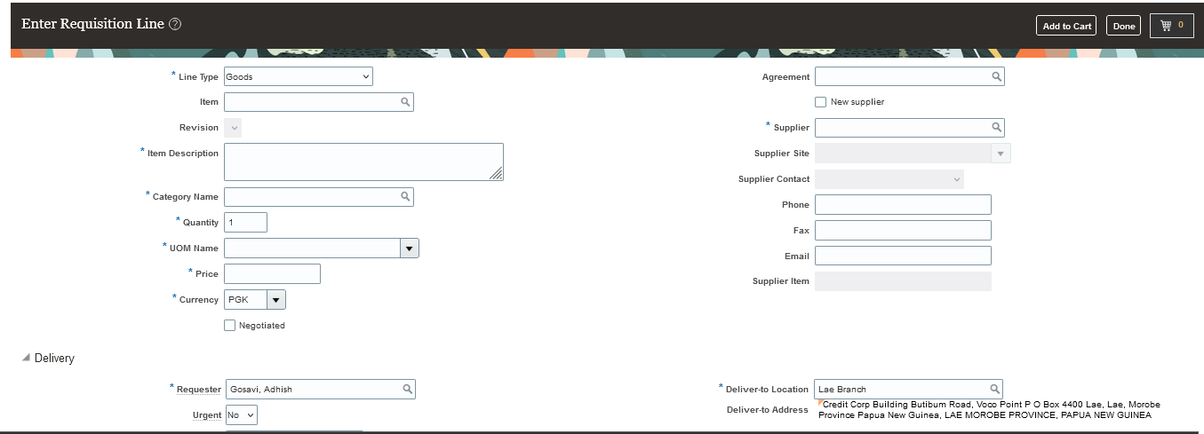
2. Sample requisition Creation

Slide 4
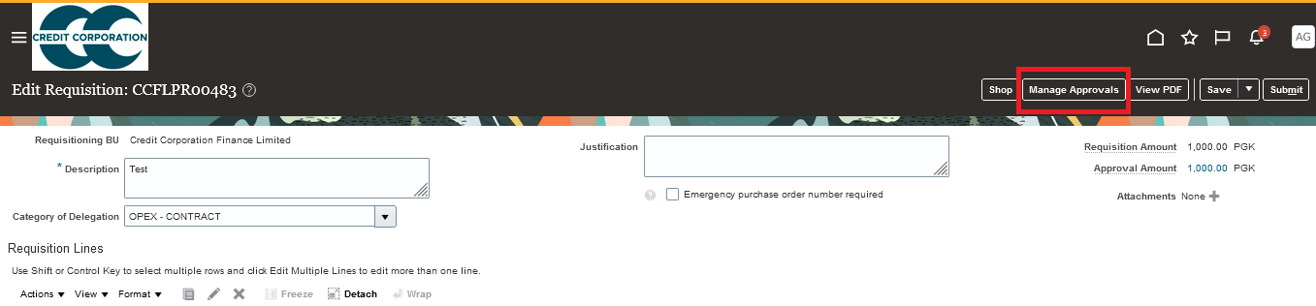
3. Introduction to Approvals

Slide 5
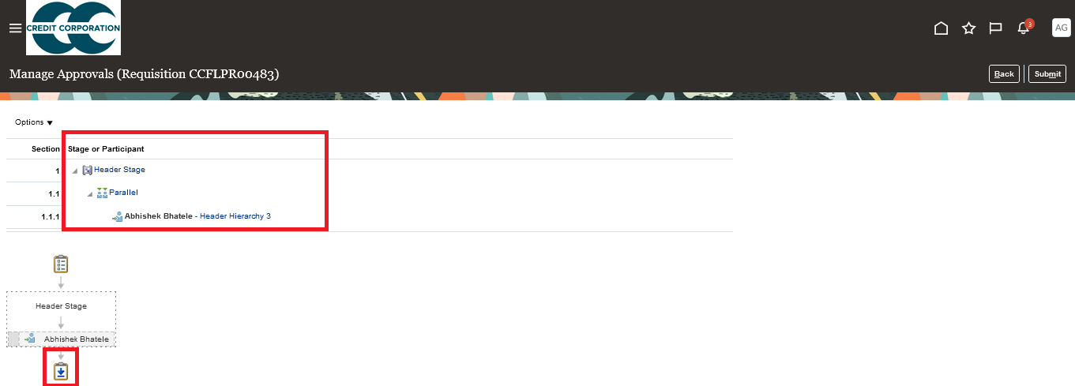
4. Approver Hirarchy

Slide 6
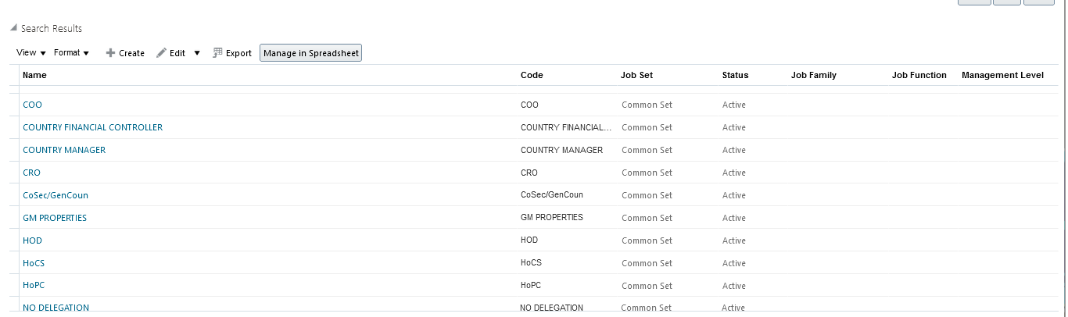
5. Job levels
A1<A2<B1<B2<C1<C2<D1<D2
Higher the job level more the approval limit.
Create Job.

Slide 7
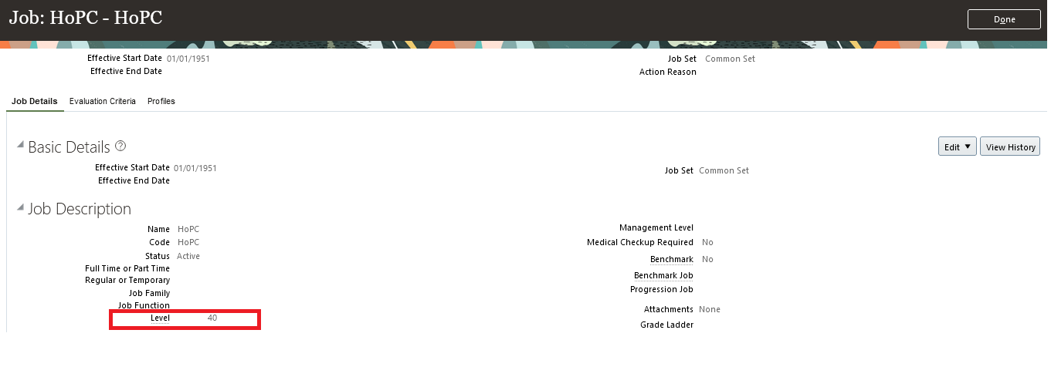
6. Job levels
1<4<10<20<40……

Slide 8
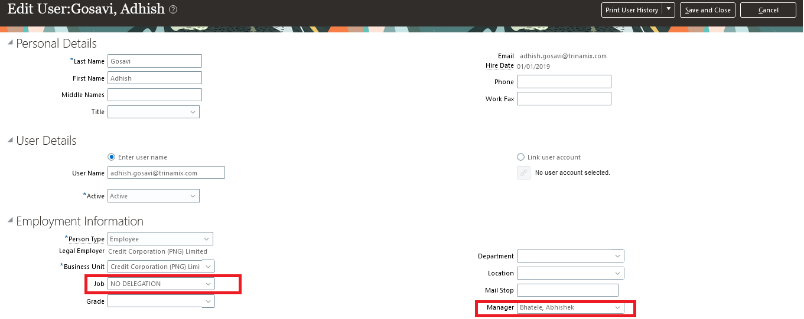
7. How to access job level
To Check- Tools- Users- Search- Name
To modify- Global Search- Manage Users

Slide 9
8. Flow of Approvals
$0 to $1000- A1
$1001 to $1500- A1 & A2
$1501 to $2500- A1 & A2 & B1
$2501 to $7300- A1-A2-B1-B2-C1-C2-D1-D2
Employee | Approval Limit
A1 | 1000
A2 | 2000
B1 | 3000
B2 | 4000
C1 | 5000
C2 | 6000
D1 | 7000
D2 | 8000

Slide 10
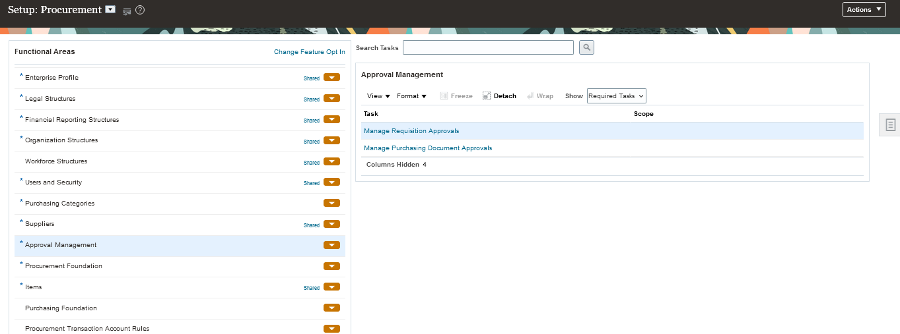
9. Approval Setup
Manage Requisition Approvals

Slide 11
10. Routing and Voting Regime
Parallel Routing
Consensus (Approver A and Approver B)
First Responder wins (Approver A or Approver B)
Serial Routing
(First Approver A then Approver B)

Slide 12
11. CC reference Jobs and Job levels

Slide 13
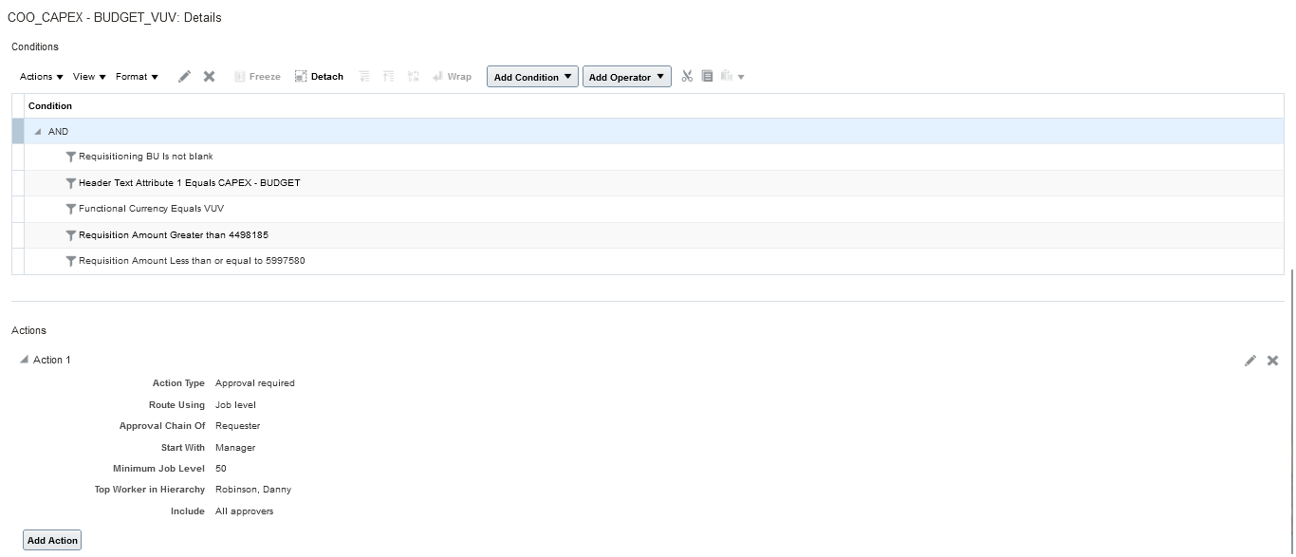
12. Setup Conditions

Slide 14
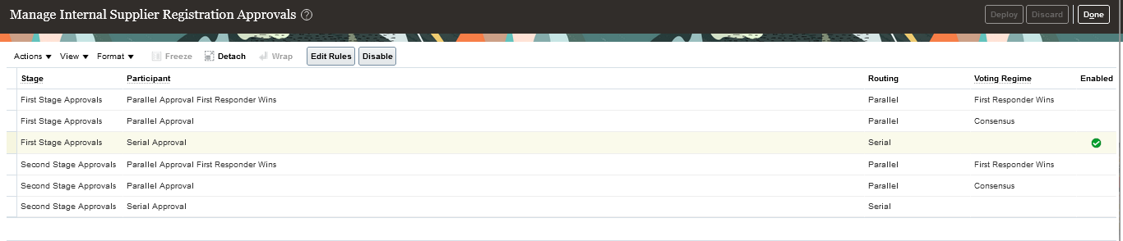
13. Supplier Approval
Manage internal supplier registration approval

Slide 15
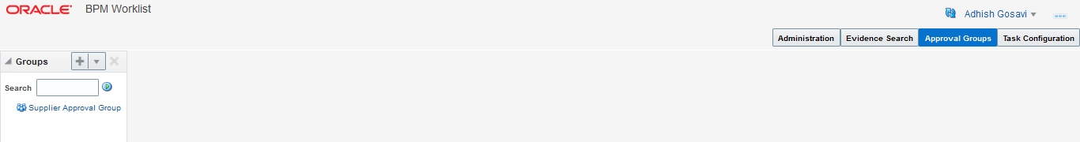
14. Approval Groups
BPM Worklist> Name> Administration> Approval Groups> Mail id of user

Slide 16
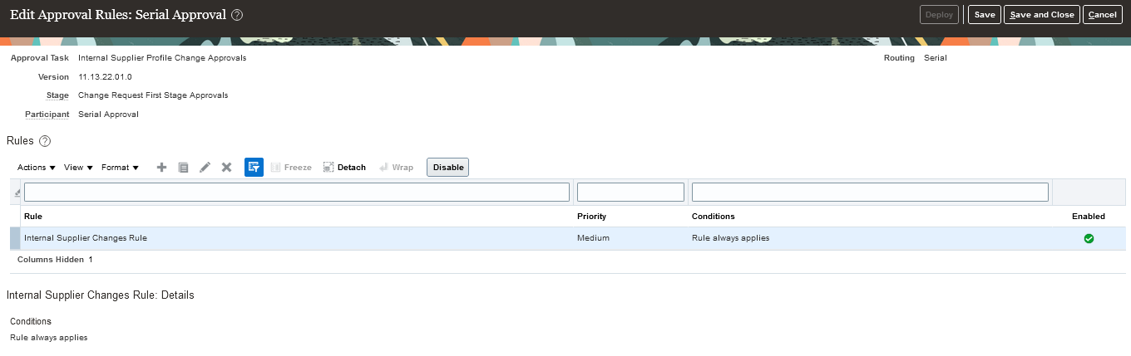
15. Internal supplier profile change approval

Slide 17
Thank you.

